Slide 1
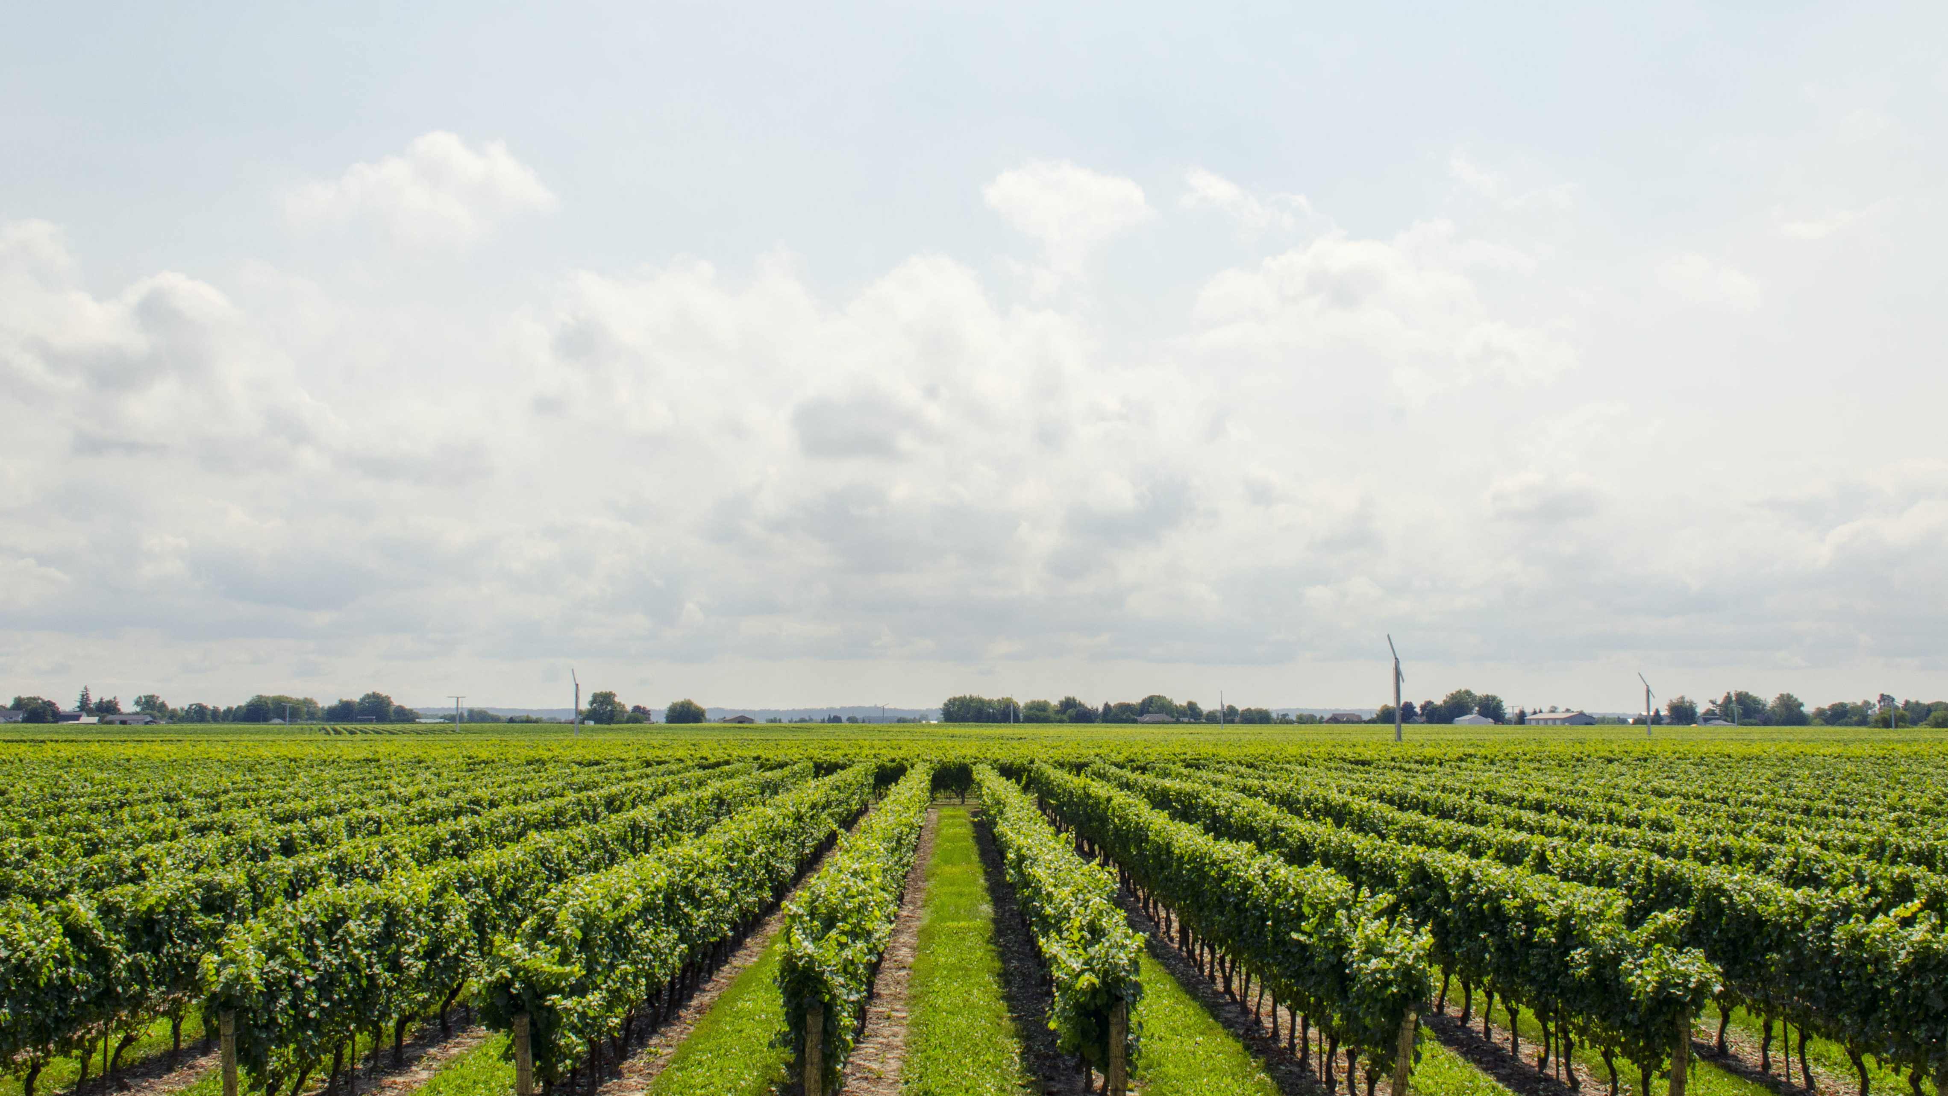
AgriCrop
Senior Project

Slide 2


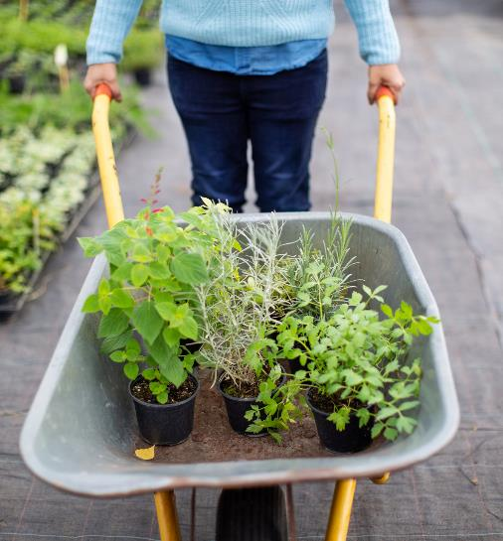

Team member:
Osama Abdulrahman Alamri
1742469
Abdulaziz Salem AL Malky
1847011
Ahmed Omar Balamsh ID
1536399

Slide 3

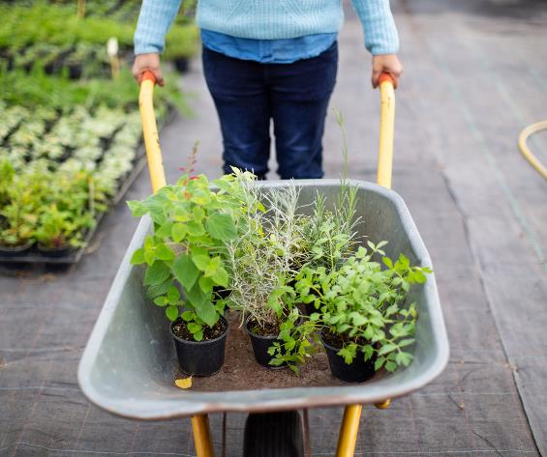
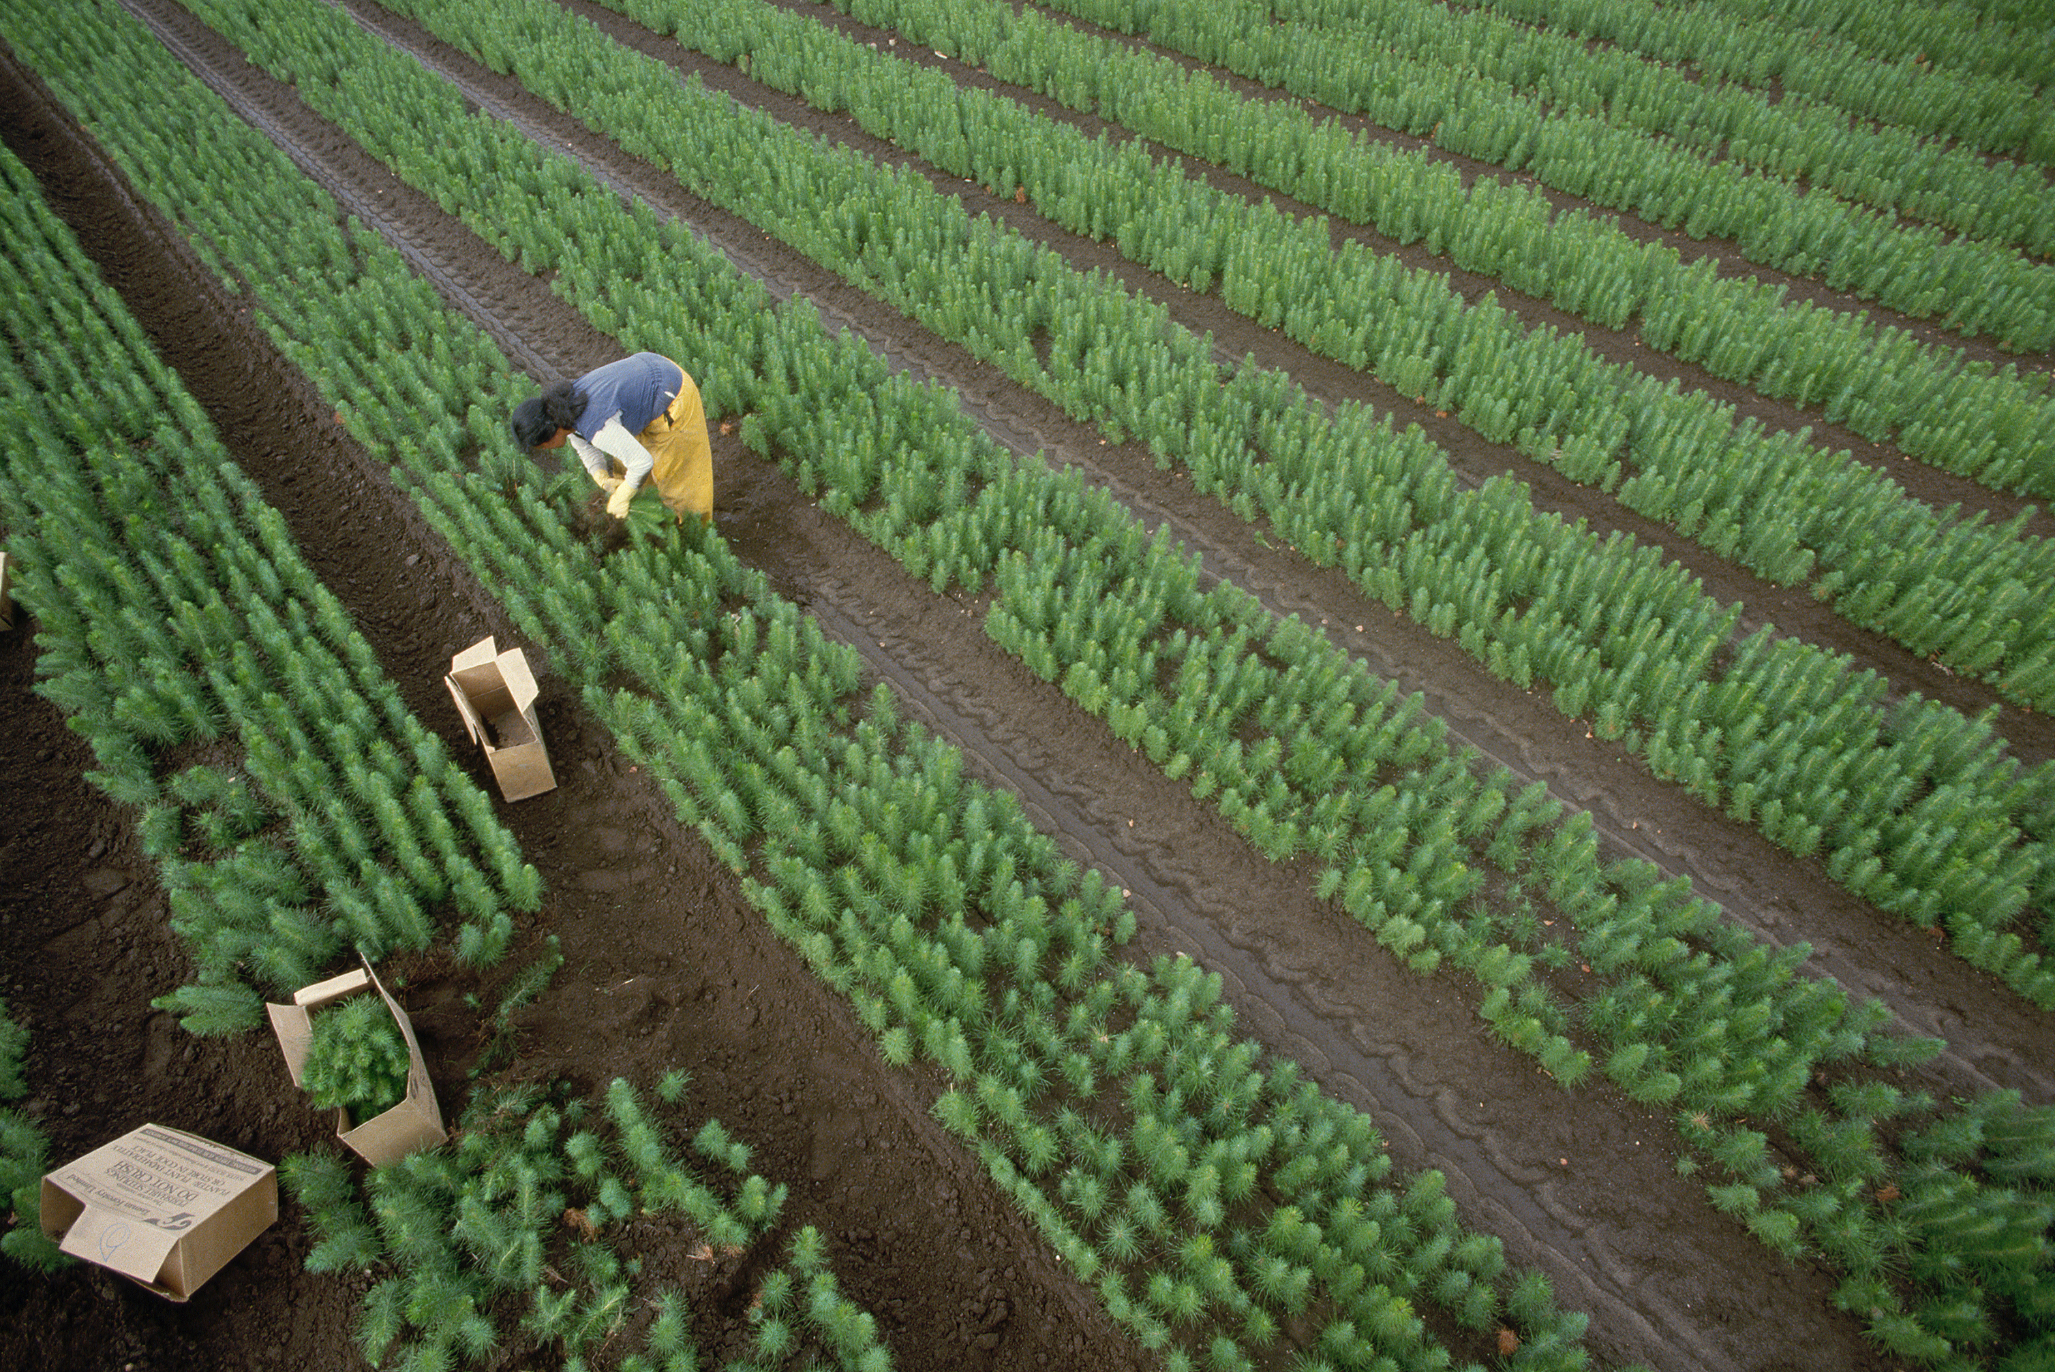
Introduction
AgriCrop is a business-to-business platform for trading Agriculture crops that let the buyer and seller meet each other through the platform.

Slide 4
This project will solve the problem of the lack of options in buying agricultural crops and difficulty of reaching them
also solves the problem of limitation to selling for local farmers as a platform that provides opportunities for farmers to profit as possible as they can and reduce costs for buyers.

Slide 5

implementation Tools
We choose our project as a website platform. So, we used several technologies like:
Front-End: HTML ,CSS ,JavaScript.
also, we used a Bootstrap framework for User-Interface.
Back-End: PHP
Database: MySQL

Slide 6

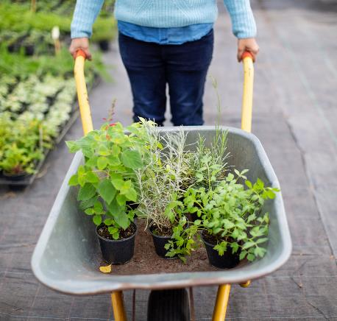
thanks for listening

